Slide 1

CLUSTERING ALGORITHMS
Exploring Different Algorithms

Slide 2
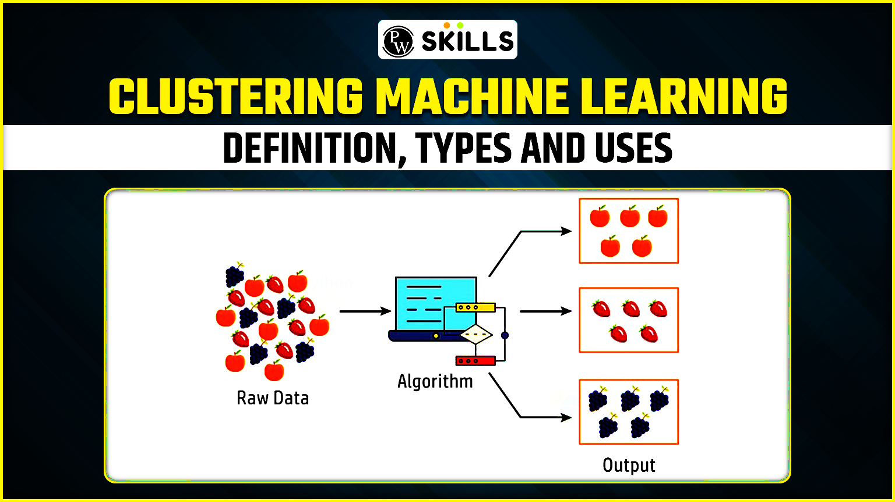
CLUSTERING Interpretation
Clustering is an unsupervised technique that groups similar data points into clusters.
It aims to find natural groupings within data without needing pre-labeled examples.
The goal is to organize data so that items within the same cluster are more alike than those in different clusters.

Slide 3

AFFINITY PROPAGATION
Affinity Propagation is a clustering algorithm that determines the number of clusters automatically and assigns data points to them based on their similarity to other data points.
It doesn't require specifying the number of clusters beforehand
It iteratively adjusts "responsibilities" and "availabilities" between data points to find the best representative for each cluster.

Slide 4
AFFINITY PROPAGATION
PROS
Automatic Number of Clusters
Handles Complex Structures
Robust to Noise and Outliers
Exploratory Data Analysis
Versatile Applications
CONS
Computational Cost
Scalability
Sensitivity to Similarity Metric
Multiple Exemplars
Memory Requirements
Not Always the Best Choice

Slide 5
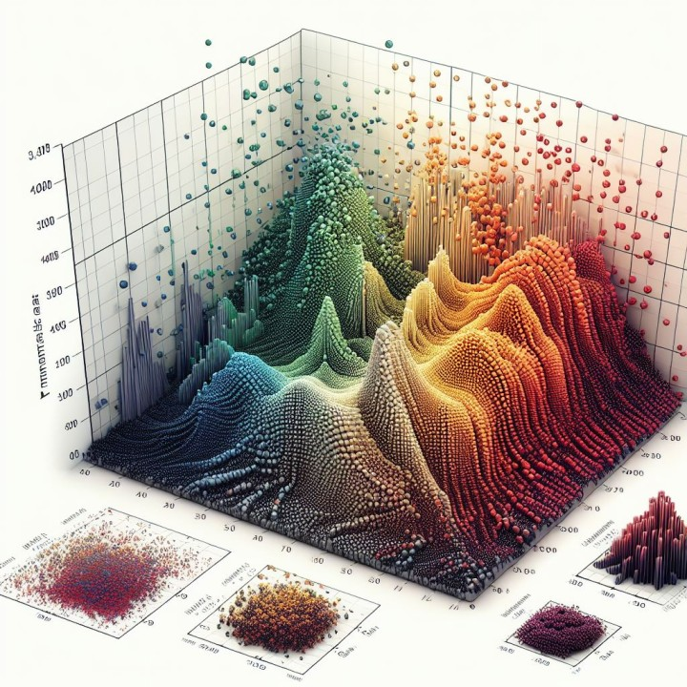
MEAN SHIFT
Mean shift clustering is a non-parametric clustering technique that identifies clusters by moving data points towards denser areas of the data.
It's a centroid-based algorithm that doesn't require specifying the number of clusters beforehand.
Instead, it iteratively shifts data points towards the modes (peaks) of the data's density distribution, effectively finding the clusters.

Slide 6
MEAN SHIFT
PROS
No need to predefine the number of clusters.
Can find clusters of arbitrary shapes.
Effective for image segmentation and object tracking
CONS
Computationally expensive.
Sensitive to bandwidth selection

Slide 7
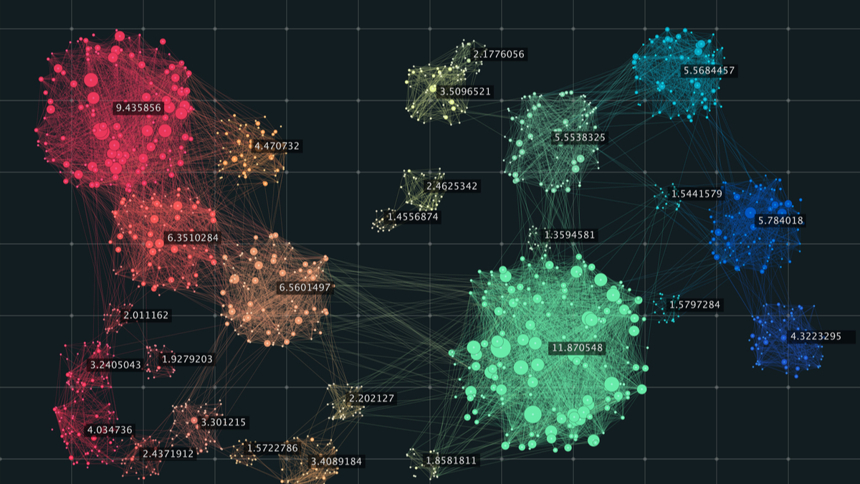
SPECTRAL CLUSTERING
Spectral clustering is a powerful machine learning technique that groups data points into clusters based on the spectrum (eigenvalues and eigenvectors) of a similarity matrix derived from the data.
It's particularly effective for data with non-linear cluster structures, where traditional methods like K-means might struggle.

Slide 8
SPECTRAL CLUSTERING
PROS
Handles Non-Linear Data.
Flexibility
Robustness to noise
Reveals hidden structures
Good for dimensionality reduction
CONS
Computational complexity
Sensitivity to parameters
Scalability issues
Requires specifying the number of clusters

Slide 9
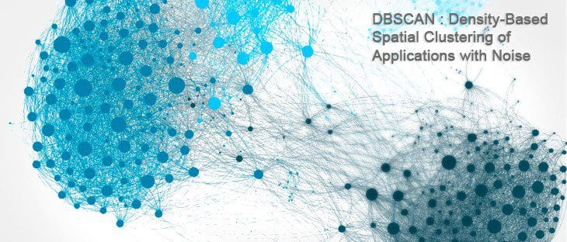
DBSCAN CLUSTERING
DBSCAN, or Density-Based Spatial Clustering of Applications with Noise, is a powerful unsupervised machine learning algorithm used for identifying clusters in data based on density.
DBSCAN doesn't require the number of clusters to be predefined and can effectively handle clusters of various shapes and sizes, as well as identify outliers.
The algorithm works by defining clusters as dense regions separated by regions of lower density. This approach allows DBSCAN to discover clusters of arbitrary shape and identify outliers as noise.

Slide 10
DBSCAN CLUSTERING
PROS
Arbitrary Cluster Shapes
Noise Handling
No Need to Define Number of Clusters
Robust to Outliers
Good for Geospatial Data
CONS
Varying Densities
High Dimensionality
Sensitivity to Parameters
Non-Deterministic
Computational Complexity

Slide 11
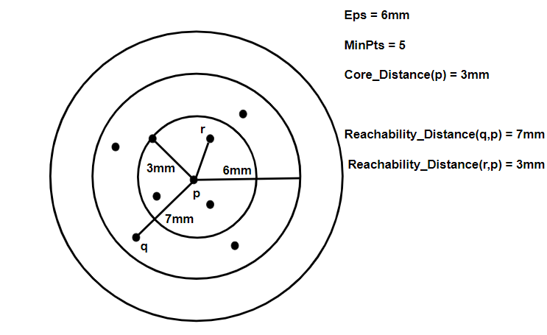
OPTICS CLUSTERING
OPTICS (Ordering Points To Identify the Clustering Structure) is a density-based clustering algorithm similar to DBSCAN clustering.
OPTICS does not directly assign clusters but instead creates a reachability plot which visually represents clusters.
Core Distance: The minimum distance needed for a point to be classified as a core point. If a point does not have enough nearby neighbors its core distance is undefined.
Reachability Distance: It is a measure of how difficult it is to reach from one point to another. It is calculated as the larger core distance of starting point and actual

Slide 12
OPTICS CLUSTERING
PROS
Handles varying densities
No epsilon parameter
Robust to noise
Hierarchical clustering
Cluster shapes
Reachability plots
CONS
Computational cost
Sensitivity to parameters
Complexity of parameter tuning
Memory usage
Interpretation of results
No unique partitioning

Slide 13
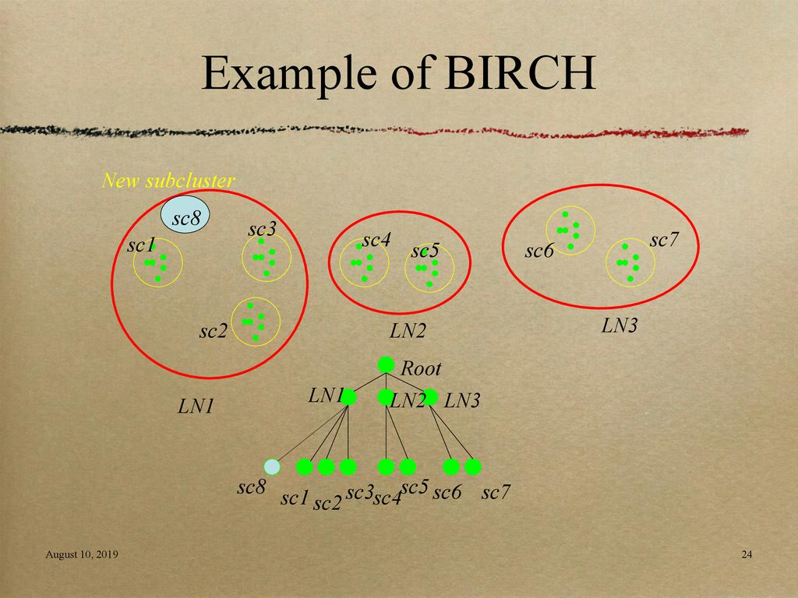
BIRCH CLUSTERING
BIRCH (Balanced Iterative Reducing and Clustering using Hierarchies) is a clustering algorithm designed for large datasets.
It provides a way to cluster data efficiently by creating a summary of the data and then clustering that summary instead of the entire dataset.
This approach allows BIRCH to handle large datasets that might be difficult for other clustering algorithms like k-means.

Slide 14
BIRCH CLUSTERING
PROS
Scalability for large datasets
Incremental data processing
Handles outliers
No requirement for pre-defined cluster number
Creates a compact summary of the data
CONS
Sensitive to parameter settings
Limited to spherical clusters
High memory overhead in high-dimensional data.
Requires metric attributes
May be affected by the input order

